Slide 1
MS&E 228: Discussion and FAQ
Vasilis Syrgkanis
MS&E, Stanford

Slide 2
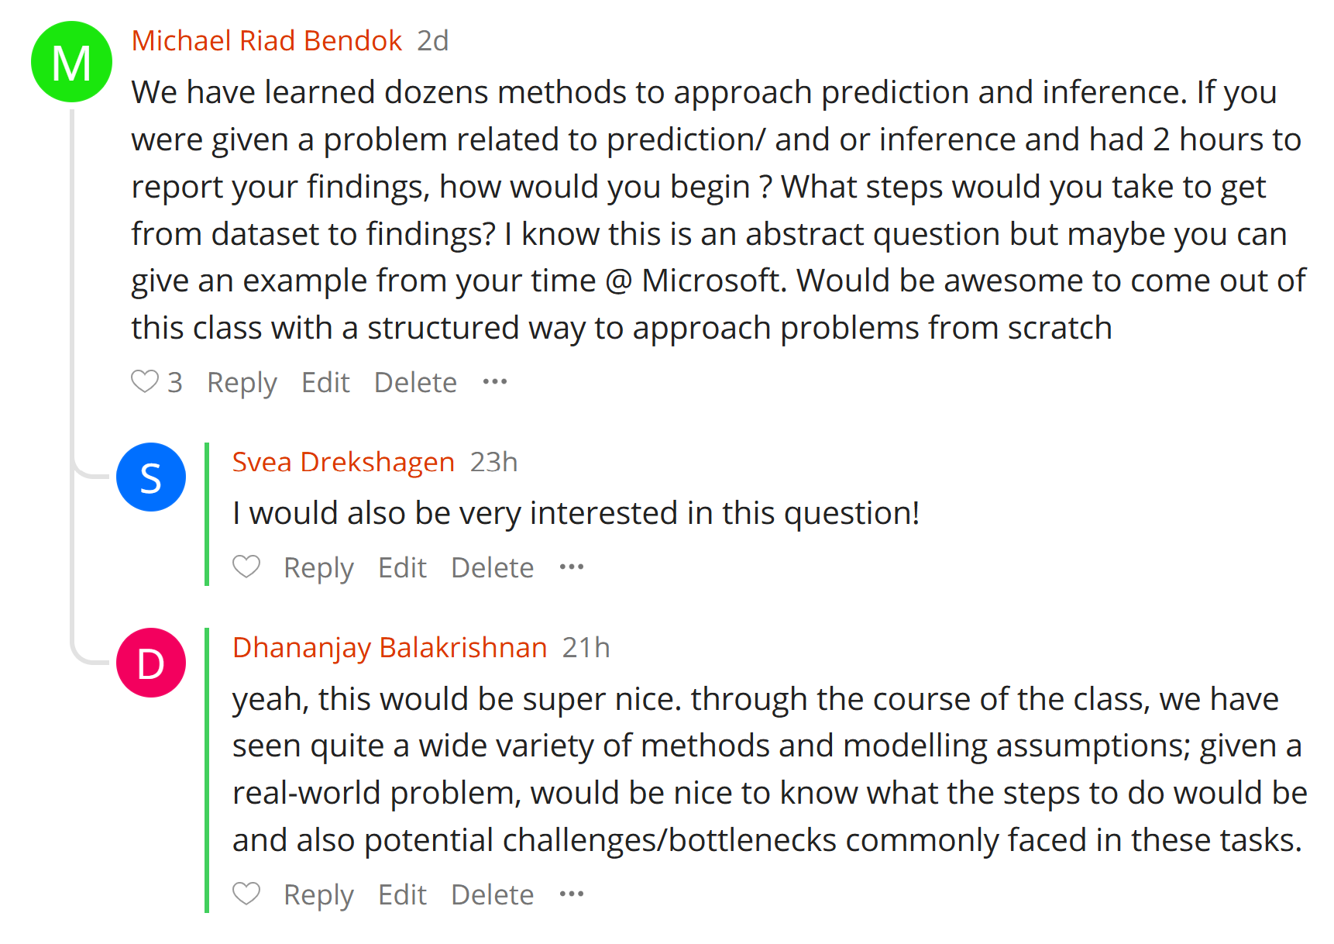

Slide 3
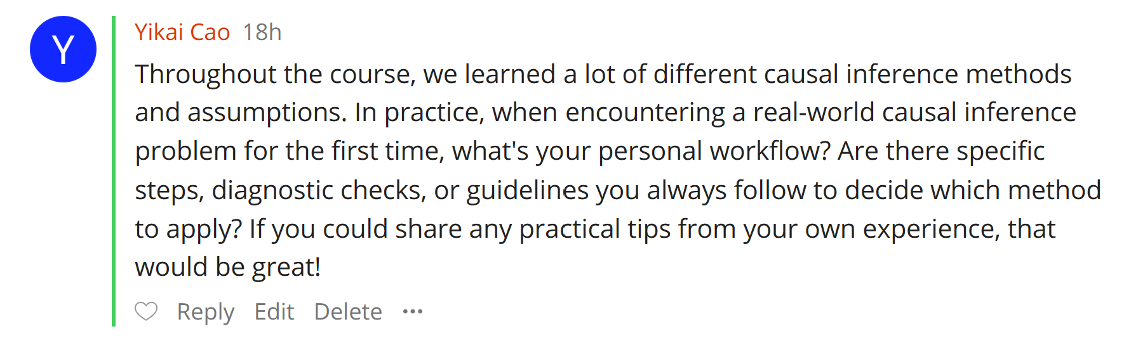

Slide 4
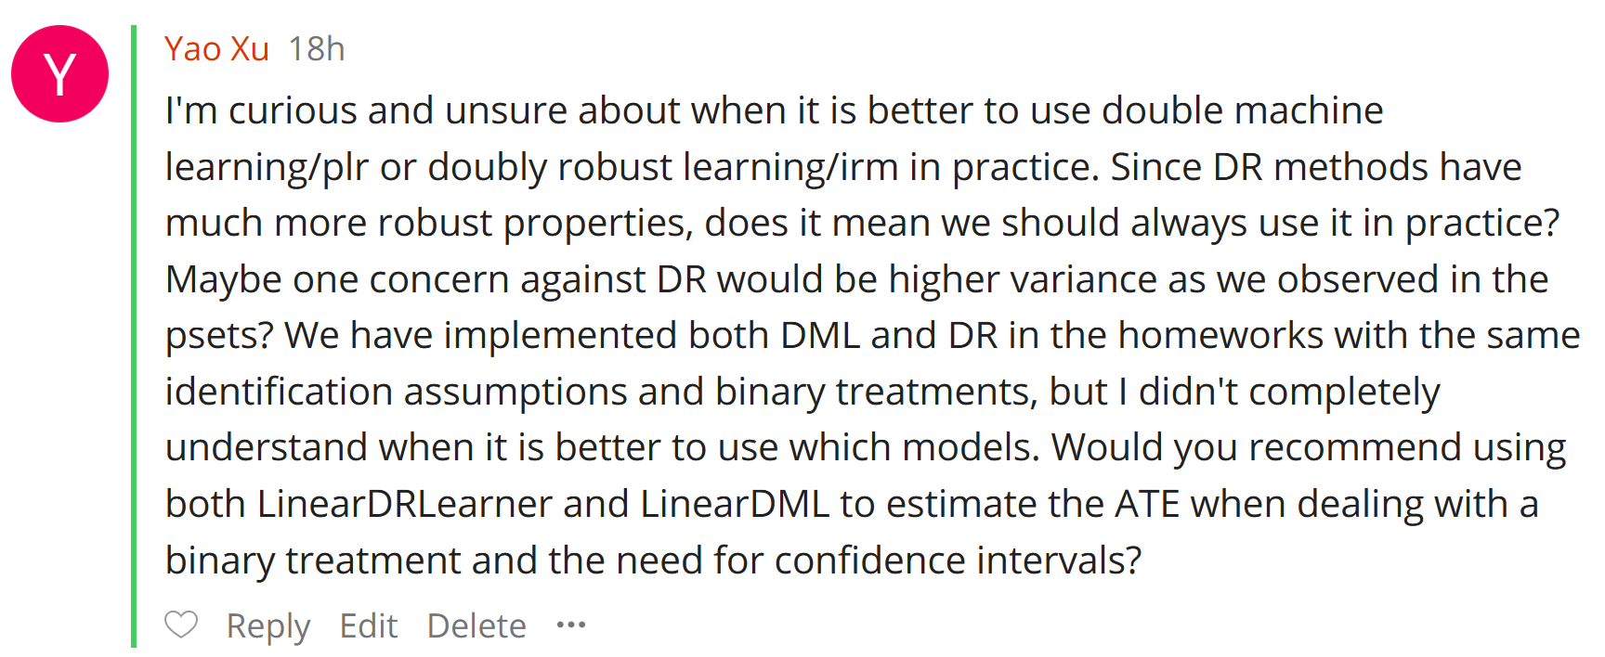

Slide 5
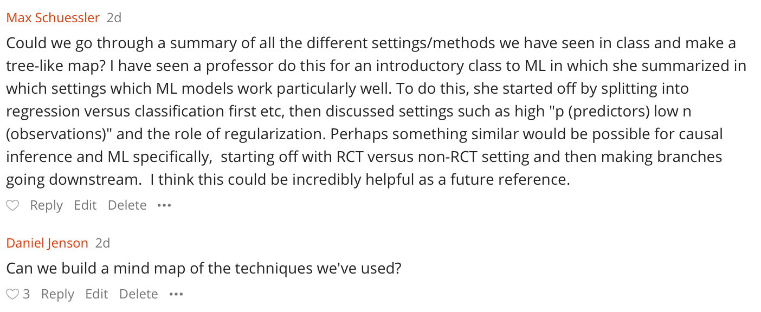

Slide 6
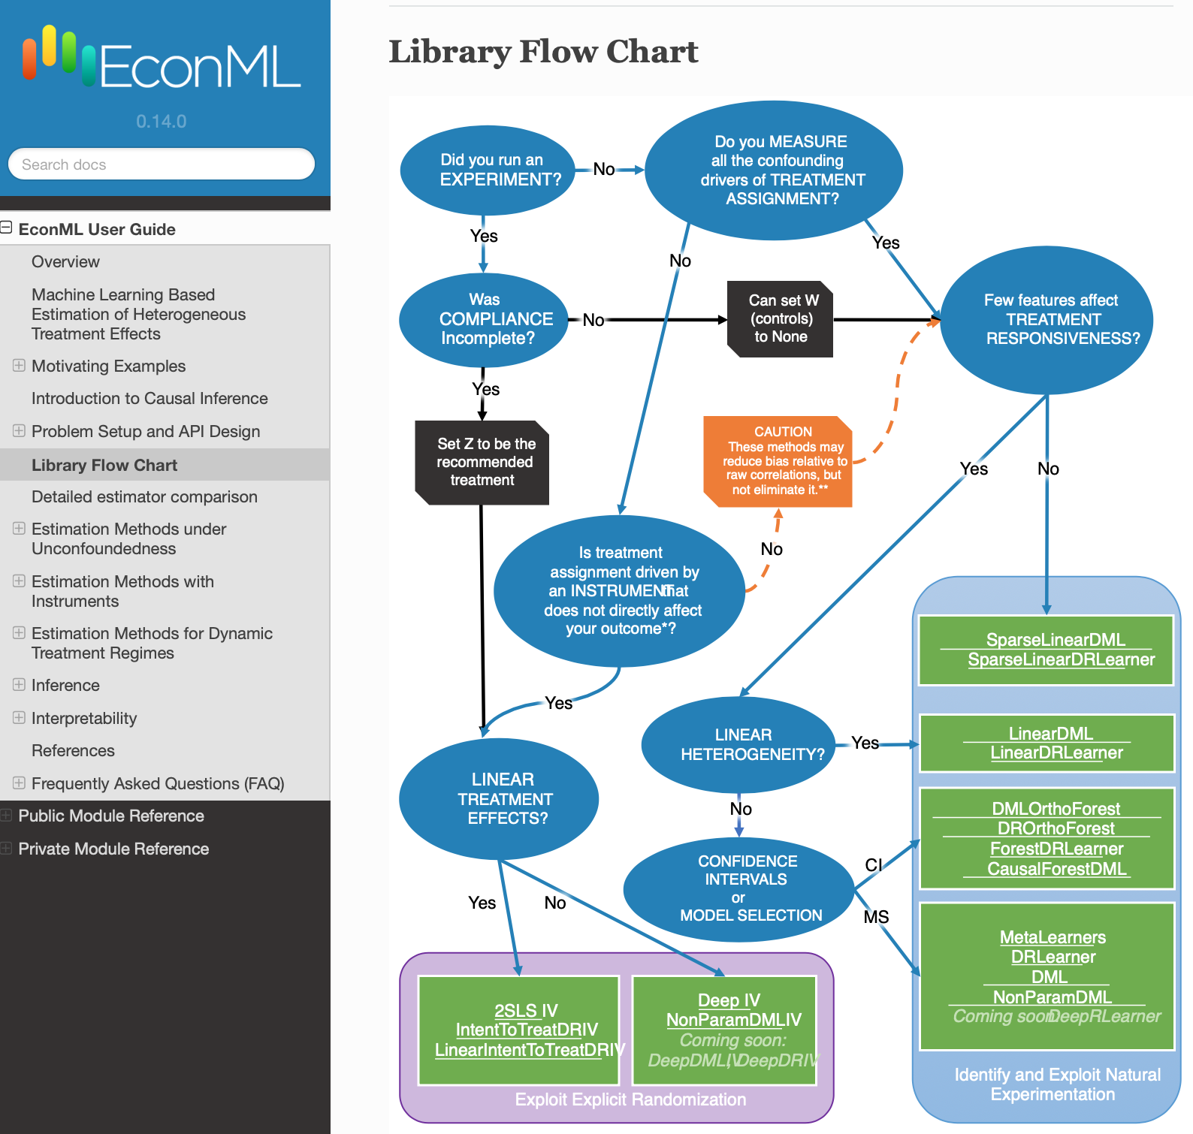

Slide 7
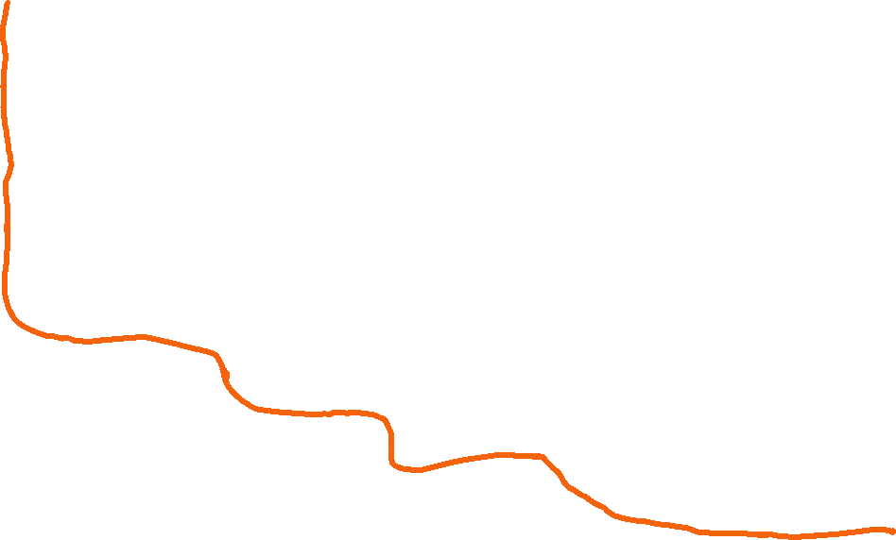
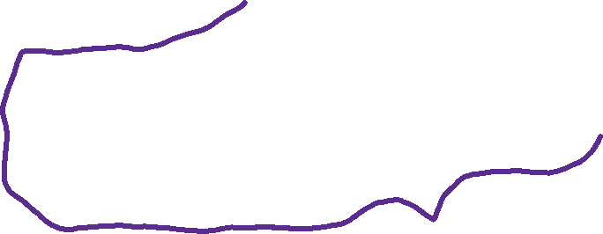
Was the treatment assigned by RCT?
Was there perfect "compliance"
(taken treatment = assigned treatment)?
Yes
Do you want heterogeneous effects/personalized policies?
No
Do you think your RCT will be "under-powered", i.e. small samples or high variance of outcome?
No
Run OLS with just Treatment (two means)
Yes
p<<n
OLS with Interactive D, D*X, X
or Doubly Robust with generic ML and hard-coded constant propensity.
Yes
Is X low-d (p<<n)?
No
Do you want to know the CATE value or just a good policy
Yes
No
View the "assigned treatment" as an instrument and "taken treatment" as the treatment
Doubly Robust with Interactive Lasso predictor for outcome and hard-coded propensity
RCT Land
p>>n
CATE
Policy
Doubly robust policy learning (e.g. over binary decision trees) and out-of-sample confidence interval for value of learned policy, with DR policy value
Do you have in your data all the variables that went into the treatment decision(s)
(or constructed a DAG and found valid adjustment set)
Do you want confidence intervals on CATE predictions or better RMSE?
Meta-Learners (S, T, X, R, DR).
Model selection with out-of-sample DR-score. Out-of-sample validation with i) DR BLP hypothesis test, ii) DR calibration score, iii) DR qini/toc curves, iv) interpretation of groups
Need (roughly n > 5k)
RMSE
Partialling-out IV regression or (2SLS after Partialling-Out)
Confidence Intervals
Are you in a high-stakes domain (want CIs to be very robust/correct under few assumptions)?
Best-Linear-Predictor of CATE using the Doubly Robust Learner on a hard-coded feature map.
Do you think that "compliance heterogeneity" and "effect heterogeneity" are independent
Yes
Yes
Doubly Robust Estimate of Local Average Treatment Effect (LATE); only for binary treatment/instrument
Use (treatment, treatment proxy) as "instruments" and (treatment, outcome proxy) as "treatments"
No
Causal Forest and Doubly Robust Honest Regression Forest
Yes
Use that factor as the instrument
IV Land
No
Do you observe "treatment" and "outcome" proxies of the unobserved confounder
Was there any discontinuity in the assigned treatment policy (e.g. treat if X1>.5)
Yes
Yes
Regression Discontinuity Methods
No
Was there any observed factor that went into the treatment decision, but you don't think can directly influence the outcome (conditioning on controls)
No
Other methods that deal with unobserved confounding
Did you observe many periods from each unit (before and after treatment)?
Yes
Diff-in-Diff or
Synthetic Controls
Yes

Slide 8
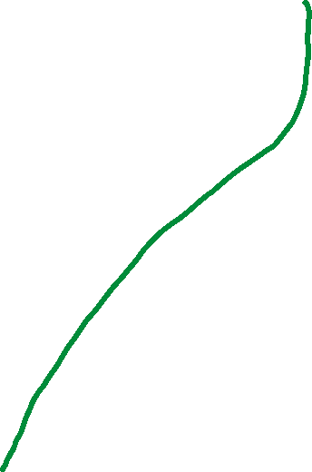
Do you have in your data all the variables that went into the treatment decision(s)
Do you want heterogeneous effects/personalized policies?
No
Do you think your outcome can be very well approximated by a linear model
Is treatment binary or categorical
Do you believe effect is constant or are you OK with low-variance "weighted averages of CATE"
Doubly Robust Estimate of ATE
Generic ML (AutoML) for outcome regressions and propensity
No
Yes
No
Yes
No
Yes
Yes
Yes
Are you sure?
Partialling-Out Estimate of ATE (potentially with "engineered treatments")
Generic ML (AutoML) for partialling out
Double Lasso with interactive D, D*X, X and look at coefficient and s.e. of D;
X are de-meaned engineered features from controls
Not really
No
Sensitivity analysis and bias bounds
Yes
Do you want to know the CATE value or just a good policy
Doubly robust policy learning (e.g. over binary decision trees) and out-of-sample confidence interval for value of learned policy, with DR policy value
Policy
Do you have longitudinal data
CATE
Meta-Learners (S, T, X, R, DR).
Model selection with out-of-sample DR-score. Out-of-sample validation with i) DR BLP hypothesis test, ii) DR calibration score, iii) DR qini/toc curves, iv) interpretation of groups
Need (roughly n > 5k)
Do you want confidence intervals on CATE predictions or better RMSE?
RMSE
Do you have multiple treatments
Do you have censoring
Yes
Yes
Dynamic Regime methods
Methods that deal with censored data that we did not talk about
Confidence Intervals
Are you in a high-stakes domain (want CIs to be very robust/correct under few assumptions)?
Best-Linear-Predictor of CATE using the Doubly Robust Learner on a hard-coded feature map.
Conditional Exogeneity Land
Yes
Caution: these methods require accurate estimation of the treatment assignment and/or the outcome processes
Causal Forest and Doubly Robust Honest Regression Forest
No

Slide 9
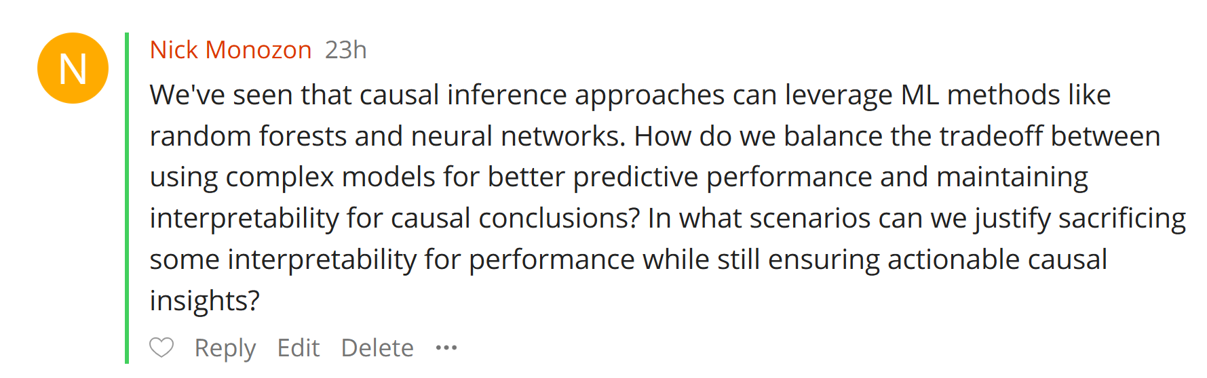

Slide 10
When ML is used as a nuisance estimator, it does not really hurt the interpretability of the target quantity.
The causal effect is identified as a function of a set of predictive models; interpretability of these models is less important, since you only care about the effect
In fact, what you really want to know from these auxiliary models is: “did you manage to squeeze out all that is predictable” (e.g. out-of-sample R^2).
So, compare causalML approach with approach that uses OLS for all prediction problems and present R^2 for each of these problems when using OLS vs when using more complex ML. If larger, that’s a good high-level argument

Slide 11
When ML is used for the target causal quantity (e.g. heterogeneous causal effects), then ML is more problematic for interpretability
But you can use all the interpretability tools that have been developed in ML, e.g. distilling into trees, SHAP values
Out-of-sample validation metrics (e.g. qini curve, calibration plots) of ML-based CATE models vs linear models is a way to justify the more complex model

Slide 12
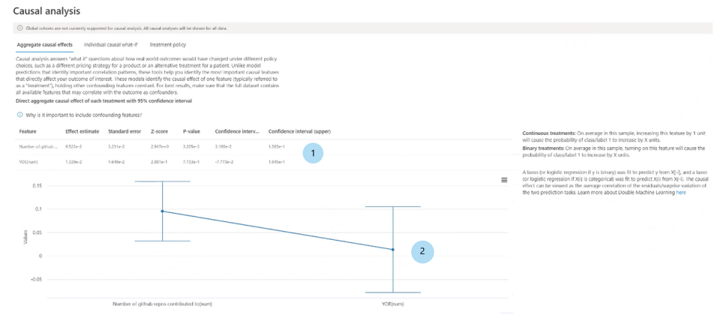
Azure Responsible AI Dashboard
Use the Responsible AI dashboard in Azure Machine Learning studio - Azure Machine Learning | Microsoft Learn

Slide 13
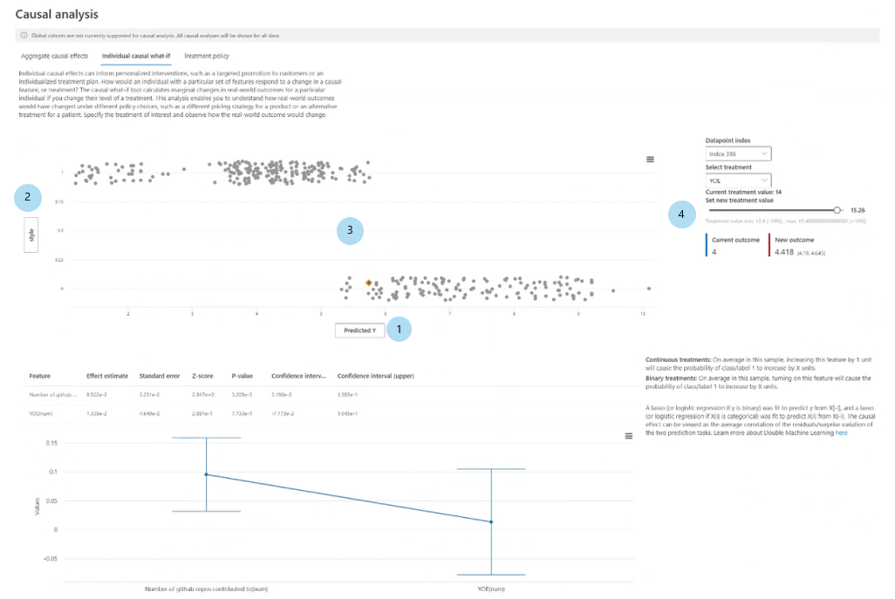

Slide 14
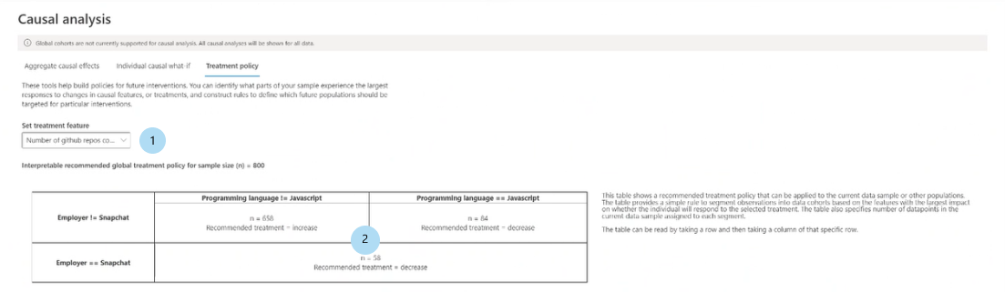
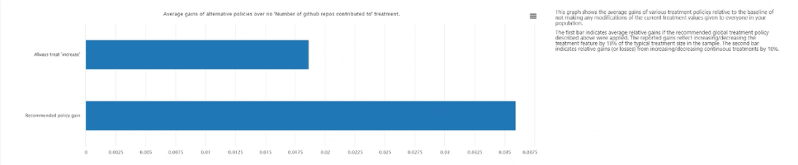
Azure Responsible AI Dashboard
Use the Responsible AI dashboard in Azure Machine Learning studio - Azure Machine Learning | Microsoft Learn

Slide 15
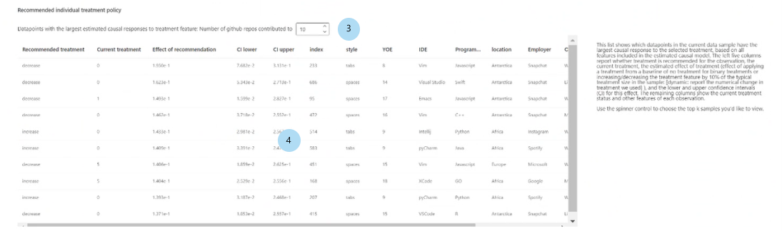
Azure Responsible AI Dashboard
Use the Responsible AI dashboard in Azure Machine Learning studio - Azure Machine Learning | Microsoft Learn

Slide 16
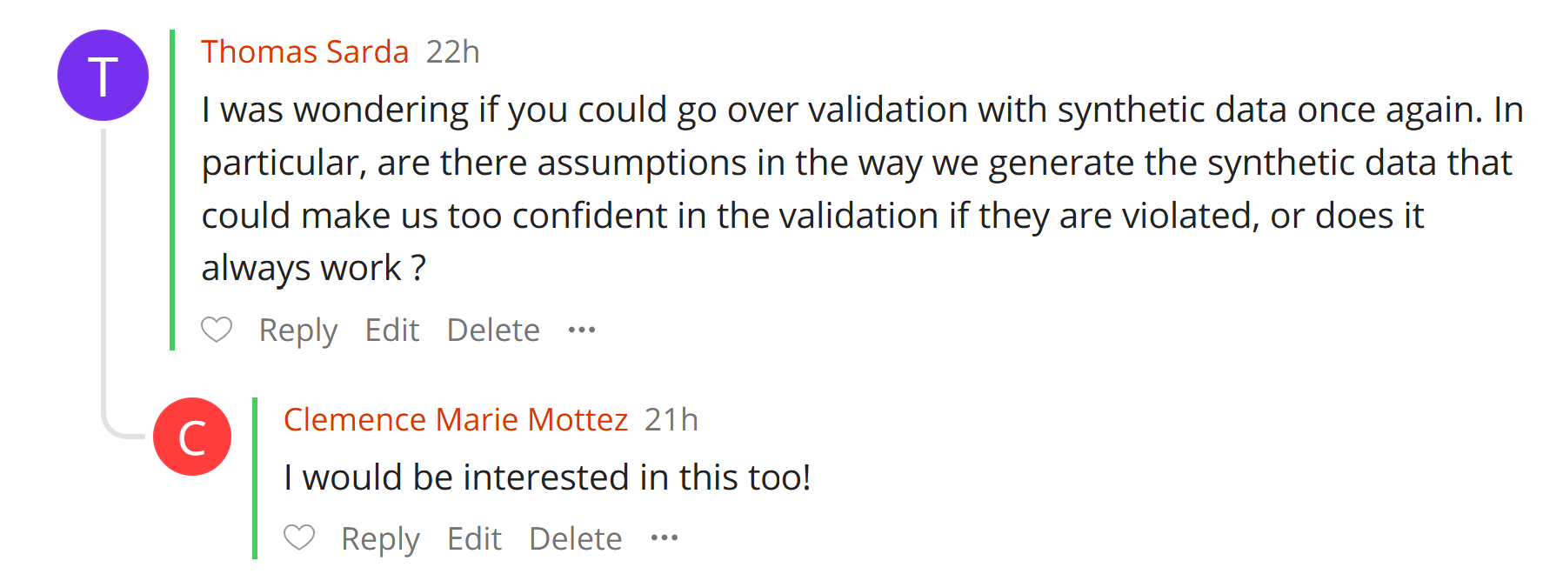

Slide 17
Performing well on semi-synthetic validation is a minimal check
One should not take it for granted that if it works on semi-synthetic validation it worked well on the real data, but not working well on semi-synthetic is worrisome
Semi-synthetic models do run the risk of being a bit simpler than the original data generating process and hence slightly easier to “succeed”

Slide 18
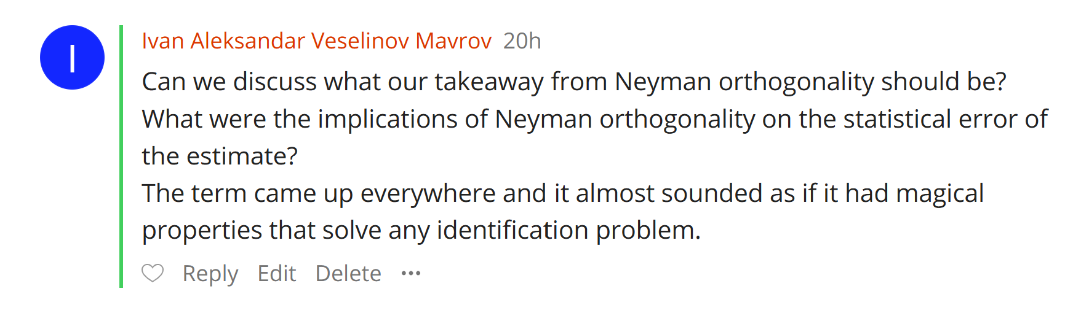

Slide 19
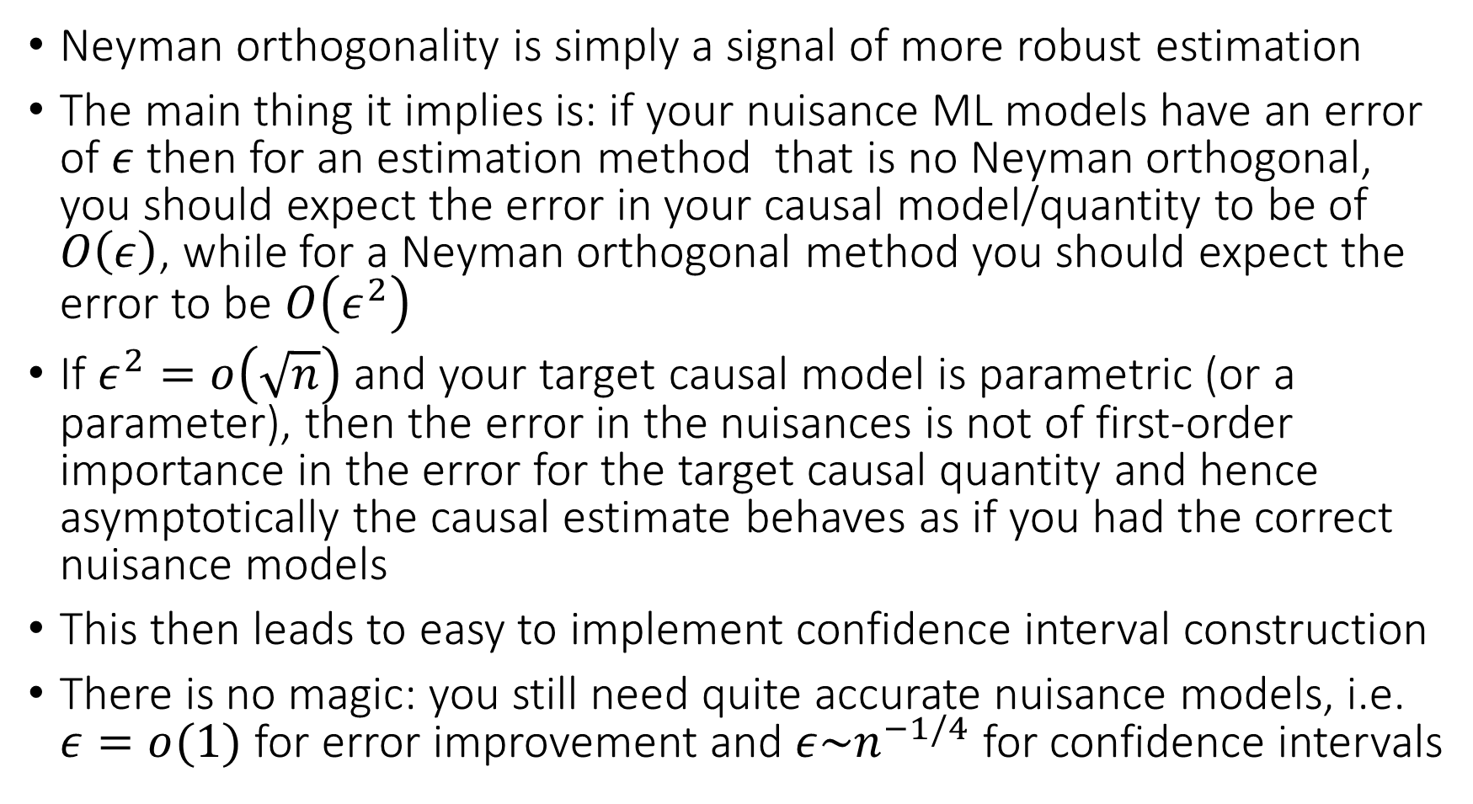
Neyman orthogonality is simply a signal of more robust estimation
The main thing it implies is: if your nuisance ML models have an error of $ε$ then for an estimation method that is no Neyman orthogonal, you should expect the error in your causal model/quantity to be of $O\left(ε\right)$, while for a Neyman orthogonal method you should expect the error to be $O\left(ε^{2}\right)$
If $ε^{2}=o\left(\sqrt{n}\right)$ and your target causal model is parametric (or a parameter), then the error in the nuisances is not of first-order importance in the error for the target causal quantity and hence asymptotically the causal estimate behaves as if you had the correct nuisance models
This then leads to easy to implement confidence interval construction
There is no magic: you still need quite accurate nuisance models, i.e. $ε=o(1)$ for error improvement and $ε\sim n^{−1/4}$ for confidence intervals

Slide 20
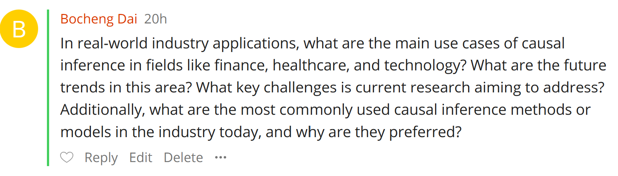

Slide 21
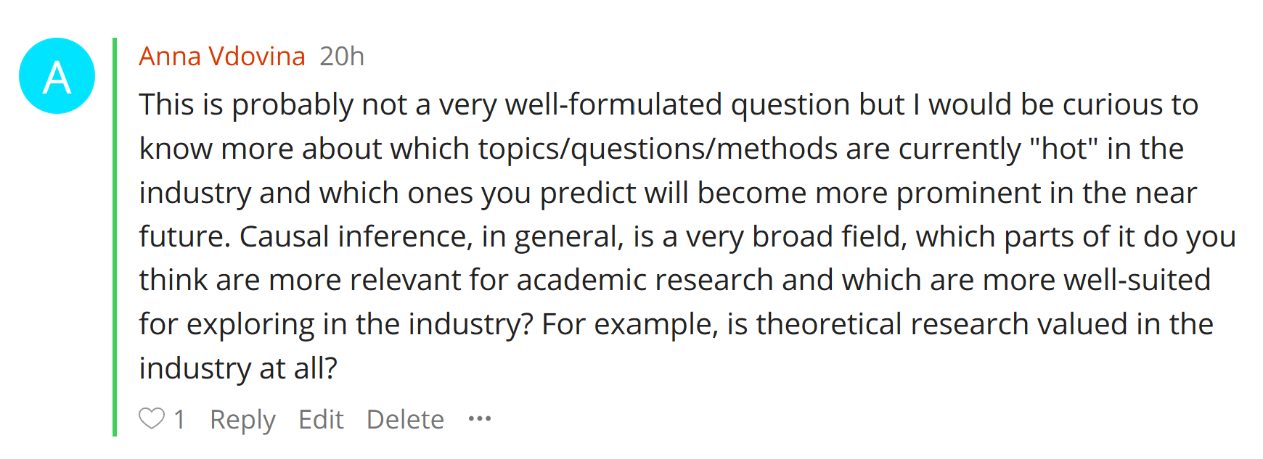

Slide 22
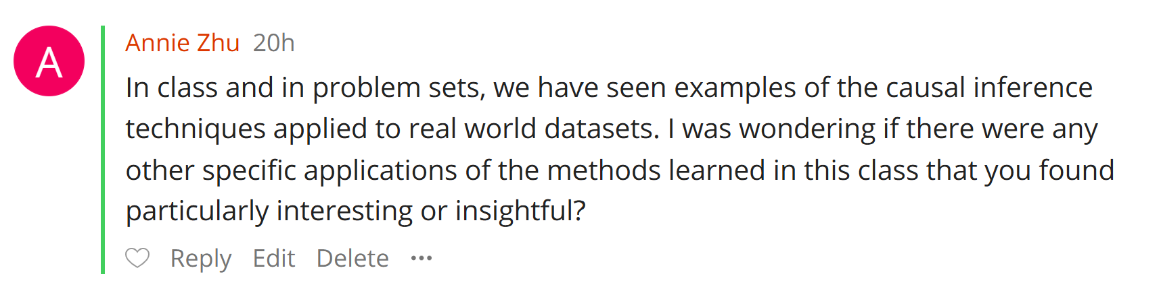

Slide 23
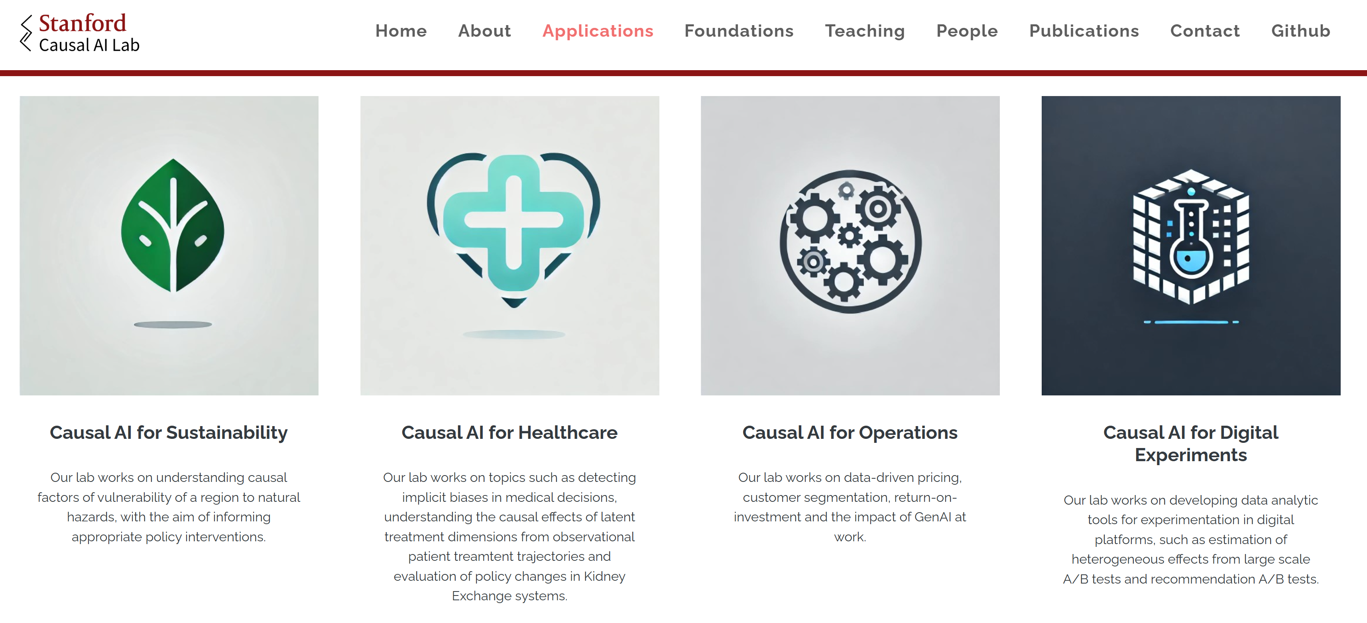

Slide 24
https://causal-machine-learning.github.io/kdd2021-tutorial/
https://drive.google.com/file/d/1QJJUCo4LH5kGQP3kaJlG1RdhjhaJWp-5/view
https://docs.google.com/presentation/d/1FvRtis2fm4c2R7XmRKWMTtZaZjUObW1fGxpNmapmjKI/edit#slide=id.ge6ef5be800_0_478
https://drive.google.com/file/d/1yyIu_3epIVXbwzJj658Iv4vxHGjtPh8n/view
https://drive.google.com/file/d/1FEKXFHHATntHjsEymXnEw6GAiUGMm8sG/view

Slide 25
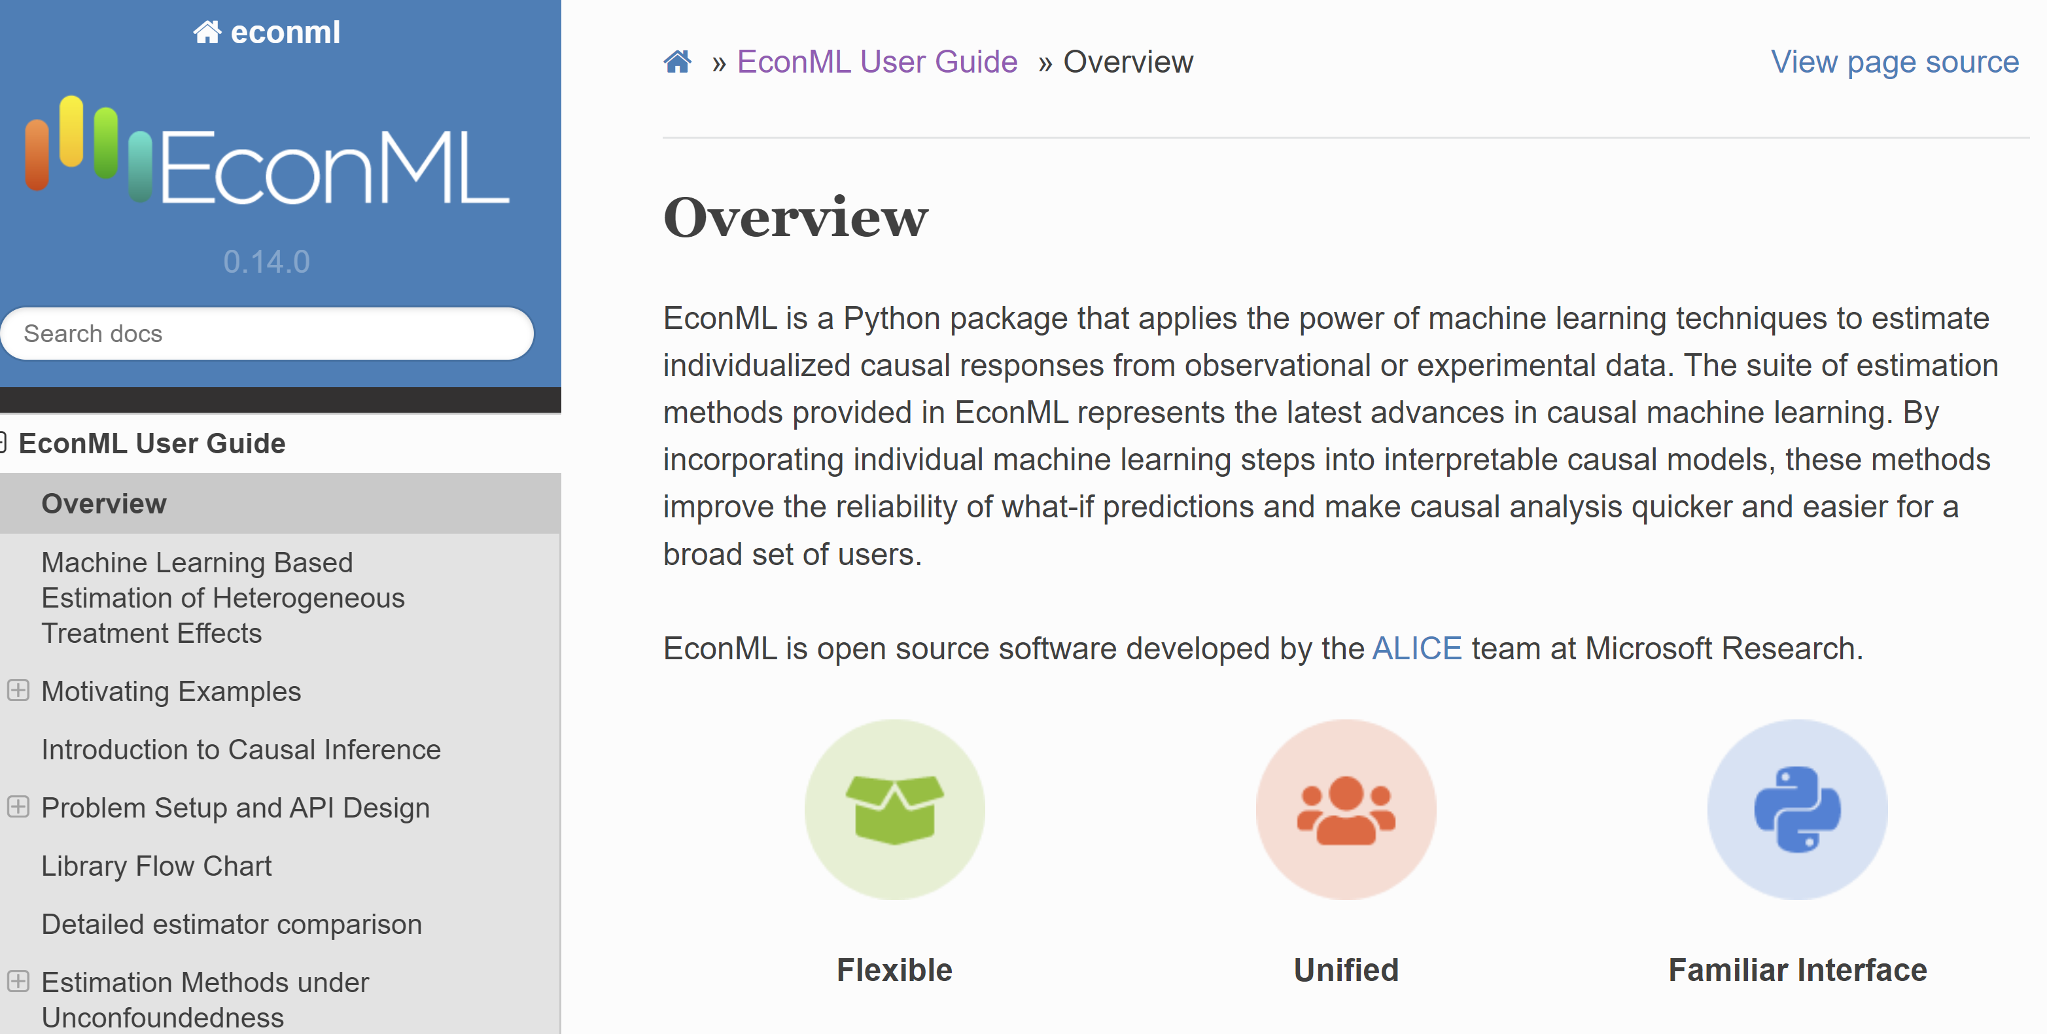

Slide 26
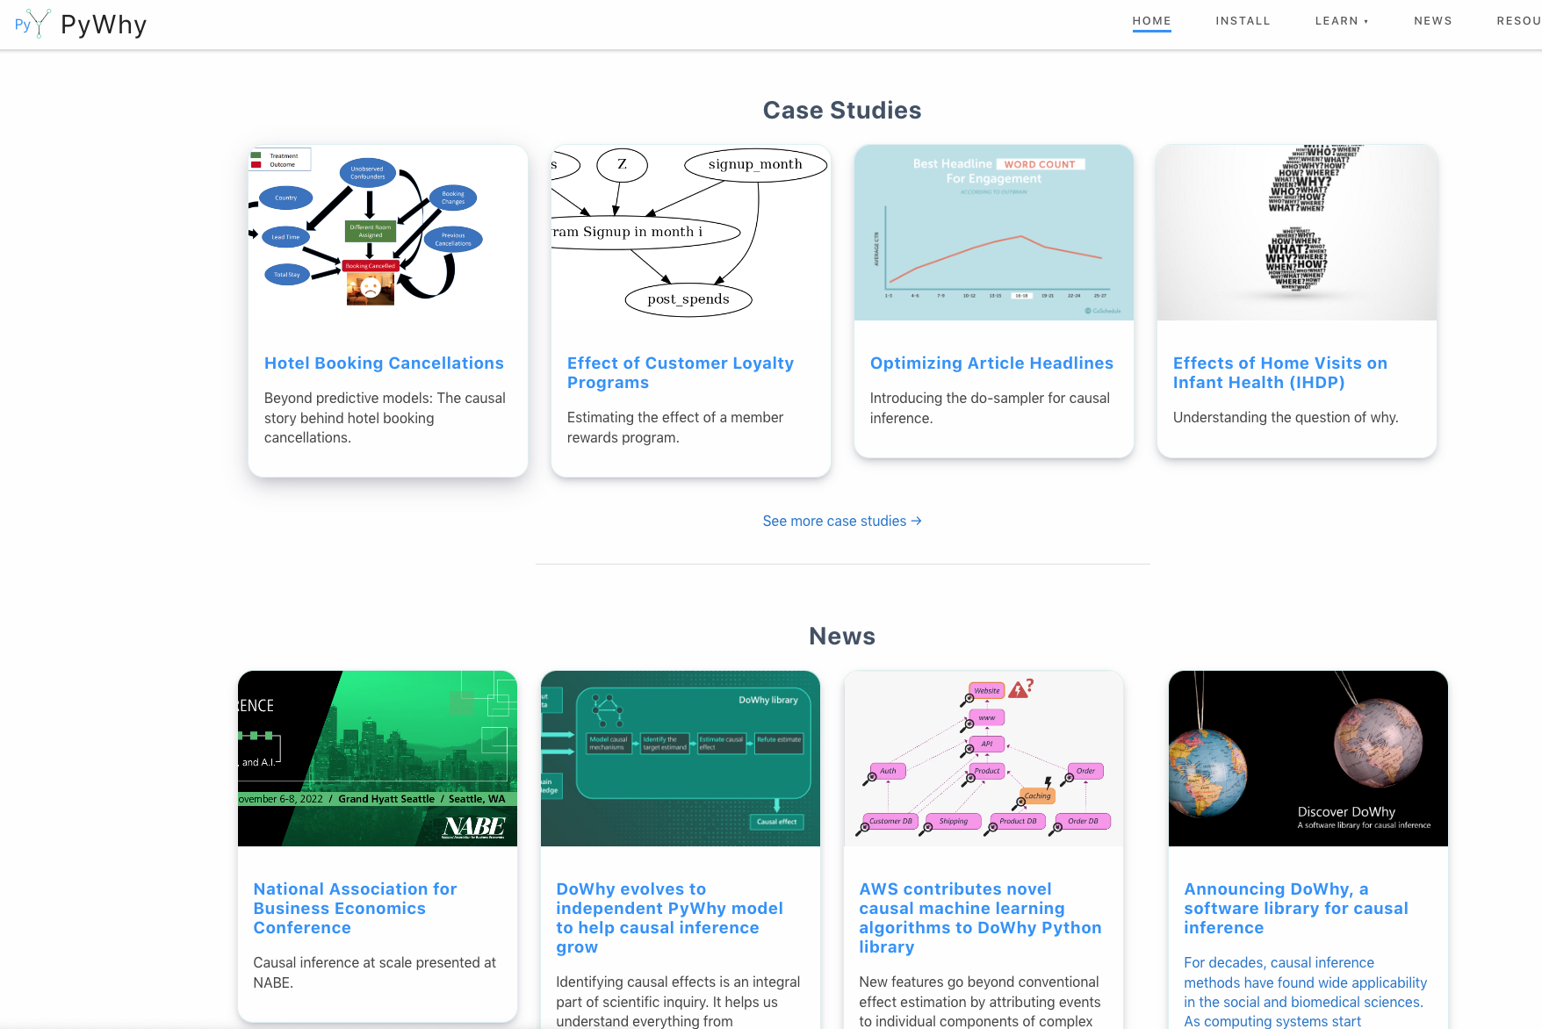

Slide 27



Slide 28
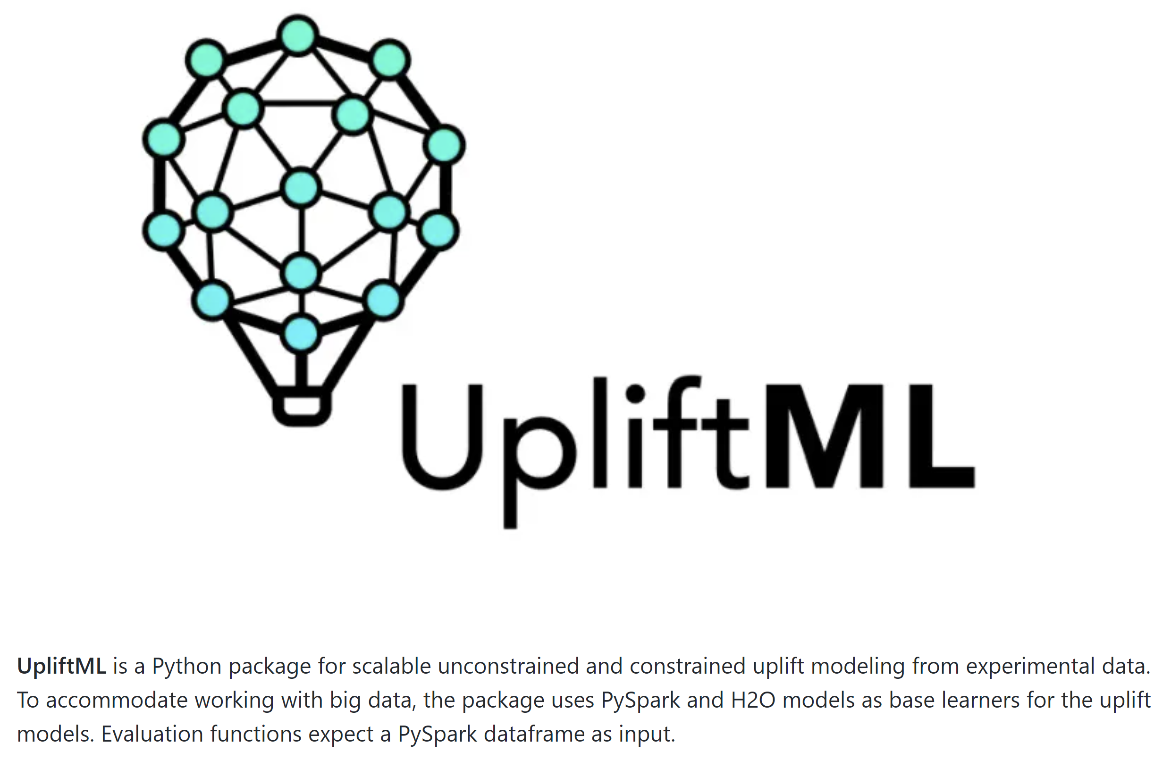


Slide 29
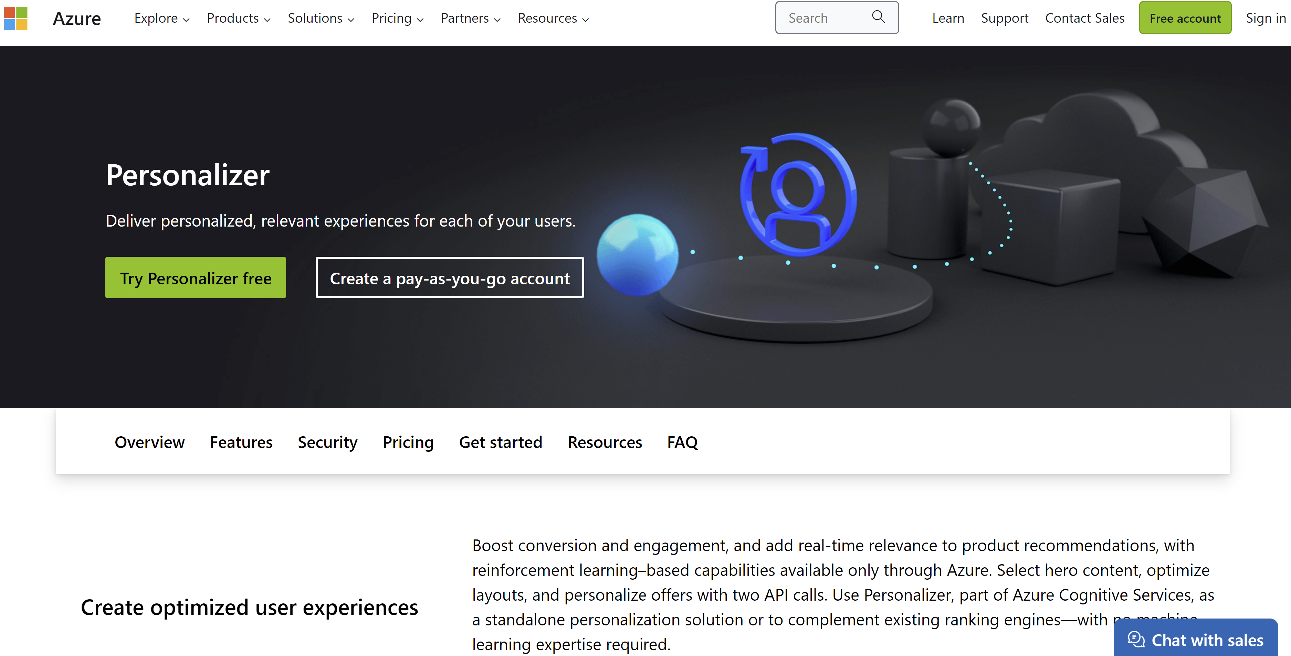

Slide 30
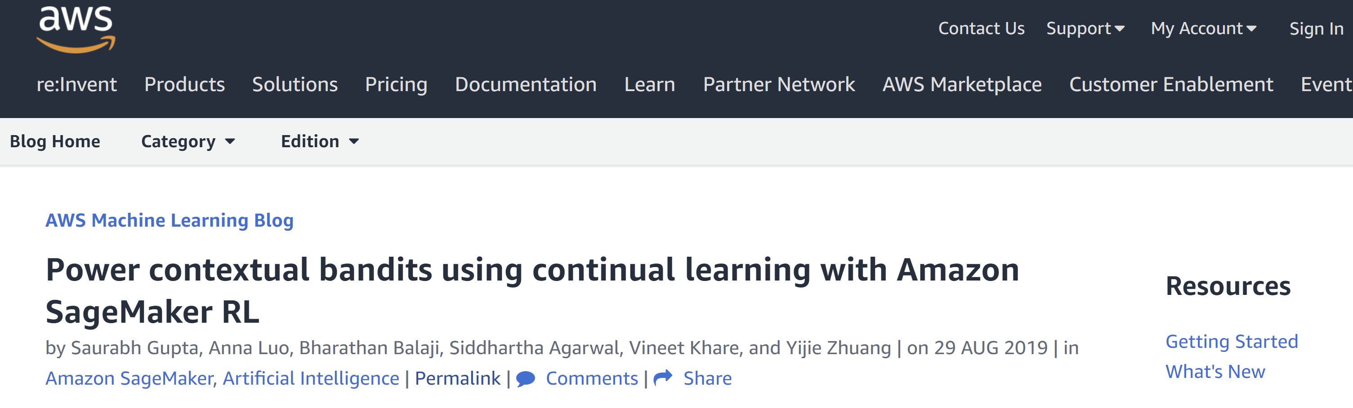

Slide 31

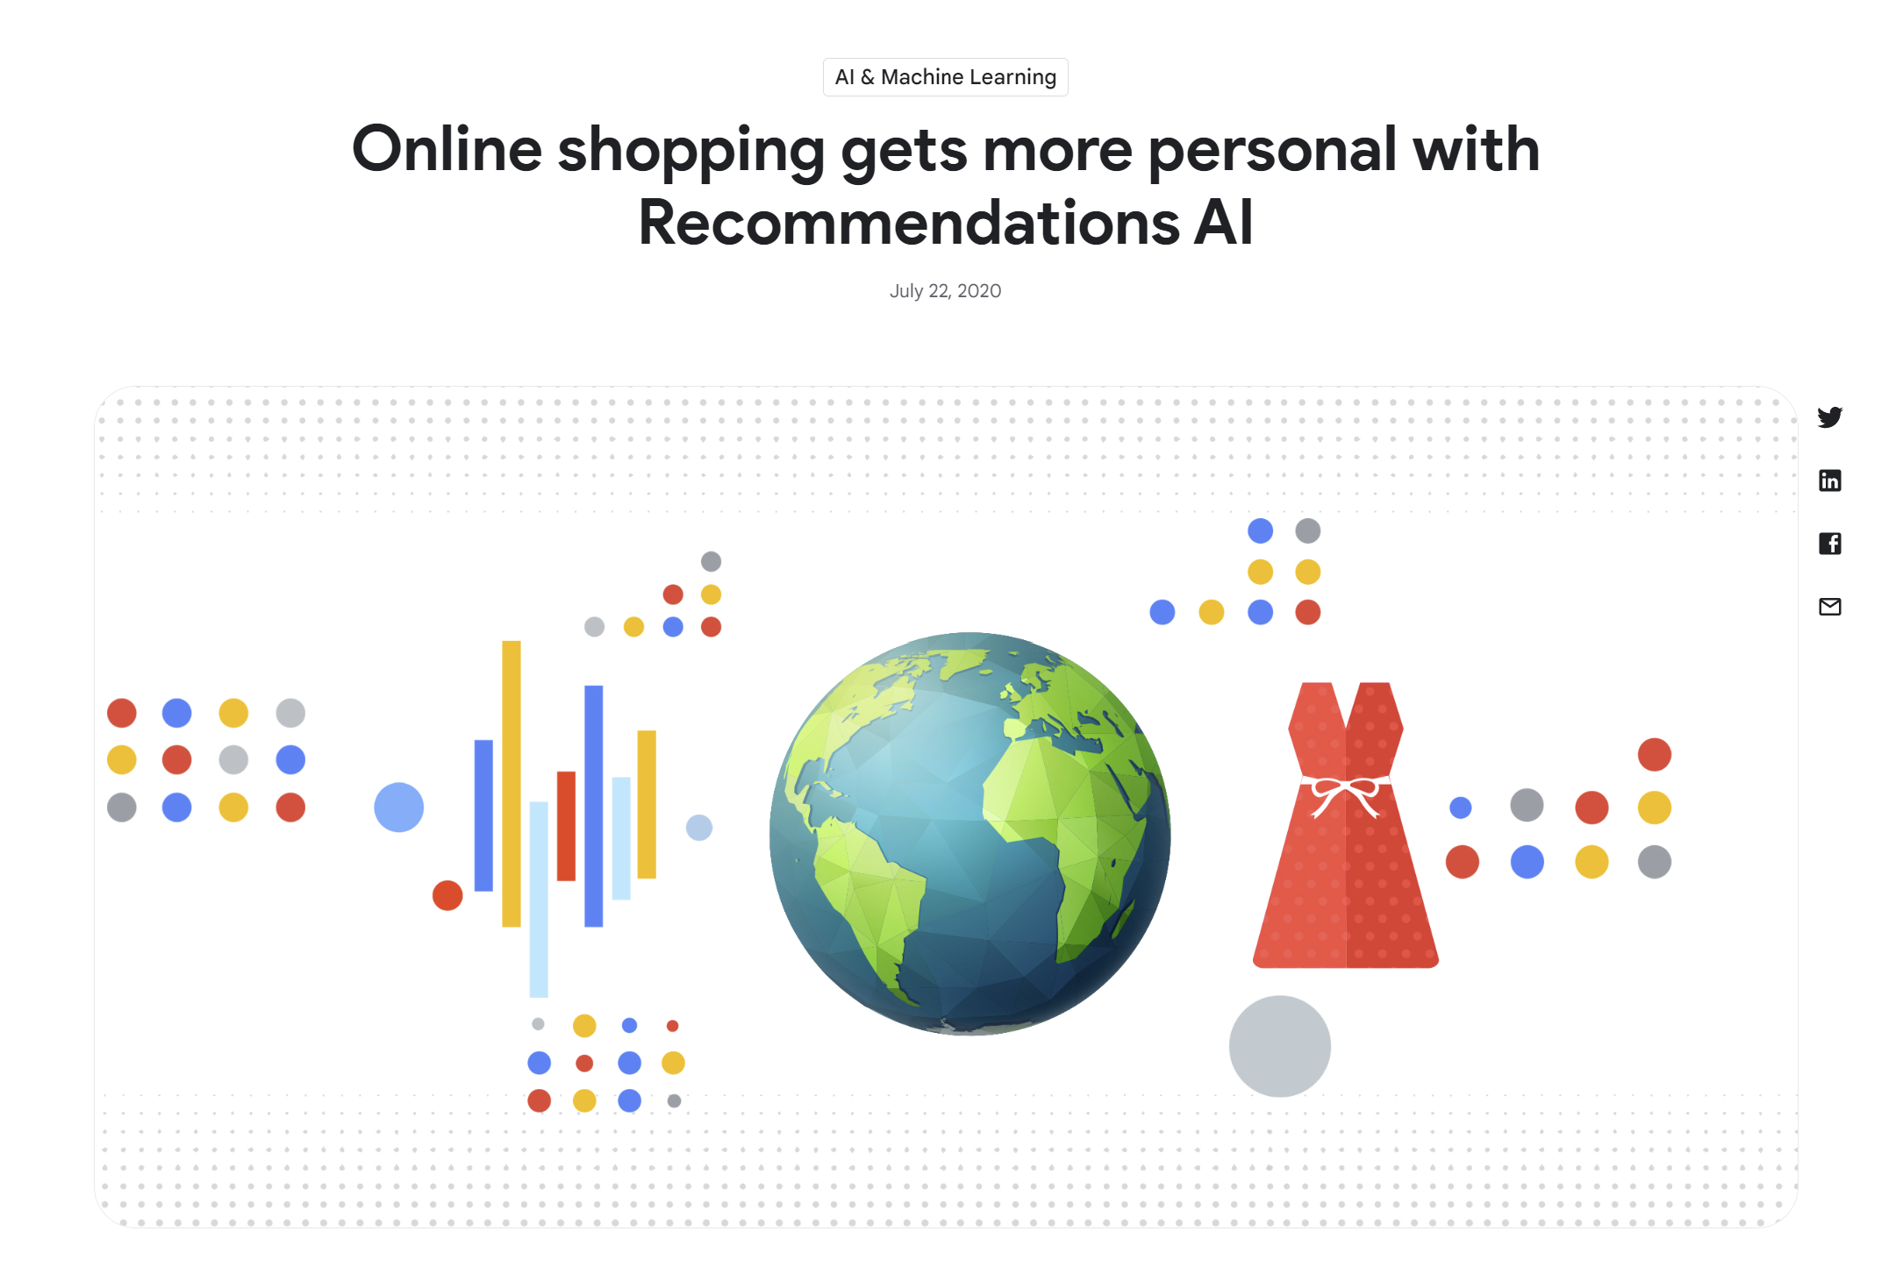
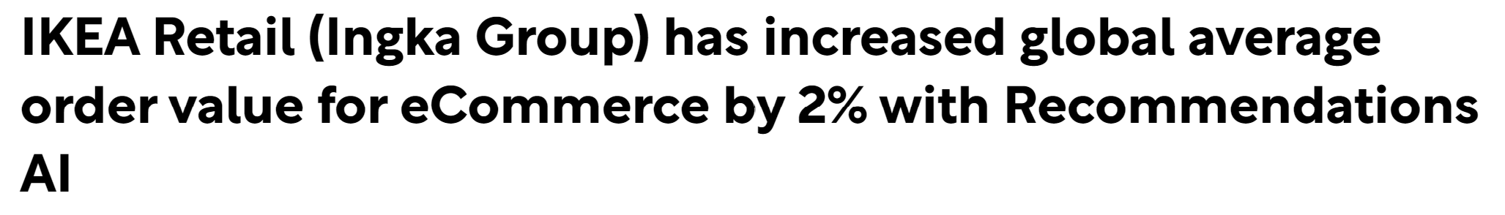

Slide 32
Many Research Challenges
Robustness to data corruption/adversarial attacks
Data Collection
[NeurIPS’17, NeurIPS’21 MLEcon workshop]
Identification Strategy
[NeurIPS’21a,b]
Estimation/Inference
[COLT’19\R&R AoS, COLT’20, NeurIPS’20, NeurIPS’21]
Sensitivity Analysis
[Arxiv’21]
Active data collection
[EC’15/OR’20, EC’26/OR21, ICML’16, NeurIPS’16, FOCS’17, ICML’18a,b, ICML’21]
Domain Assumption Elicitation
[Clear’22]
Interpretation/Policy Recommendations
[NeurIPS’19, ICLR’21,CLear’22]
Validation
[COLT’19]
Long-term outcomes
Safety constraints
Fairness and ethical constraints
Experimentation constraints (ability to intervene on subsets of variables)
Interactive assumption elicitation (query complexity)
Causal Representation Learning for unstructured data
Incorporate non-graphical restrictions in automated graph-based identification algorithms
Computationally efficient sensitivity analysis
Automated de-biasing in general (e.g. dynamic regime, mediation effects)
Unobserved confounding
Post adaptive data collection inference
Post causal discovery inference
Evidence based interpretations for policy makers
Causal attribution
Good losses for causal model selection

Slide 33
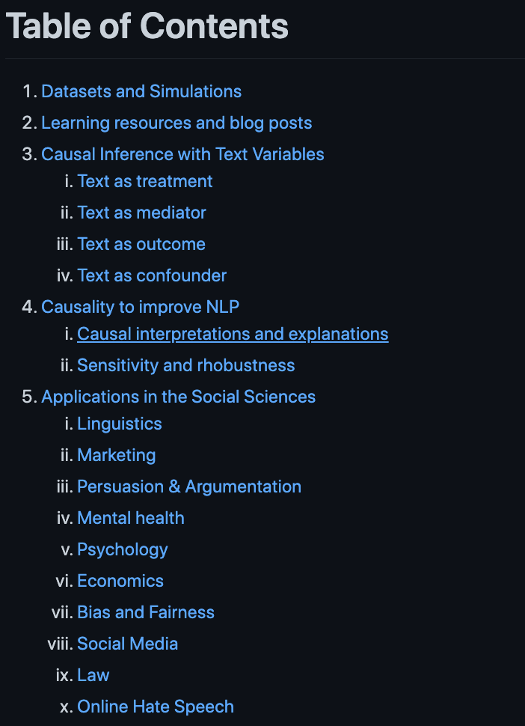
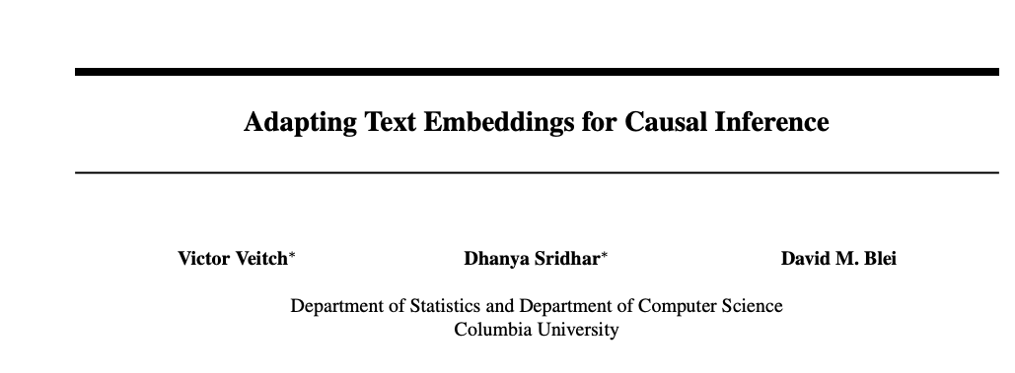
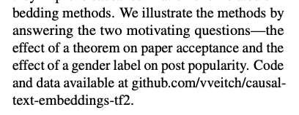
https://github.com/causaltext/causal-text-papers

Slide 34
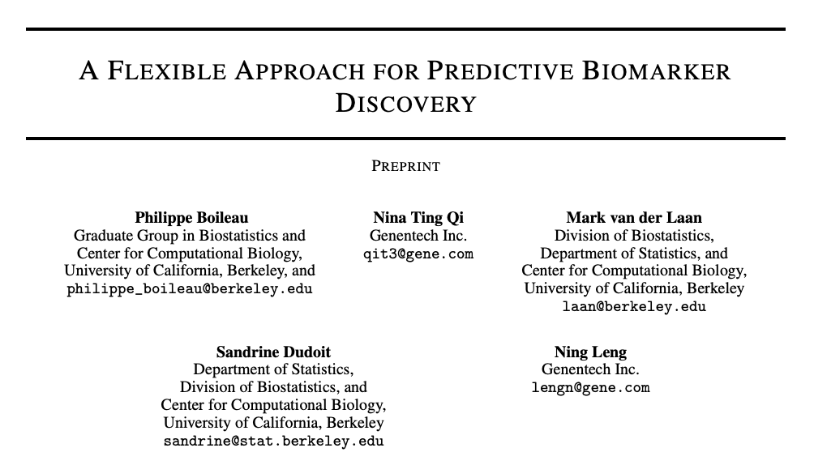
https://insitro.com/

Slide 35
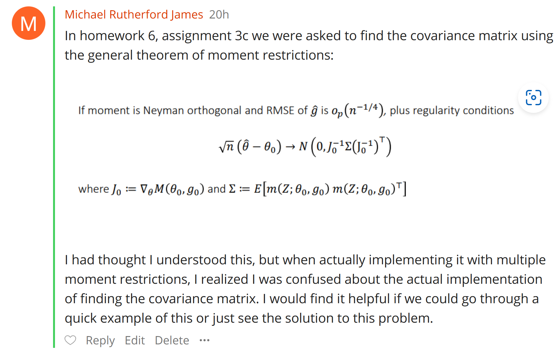
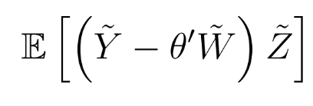

Slide 36
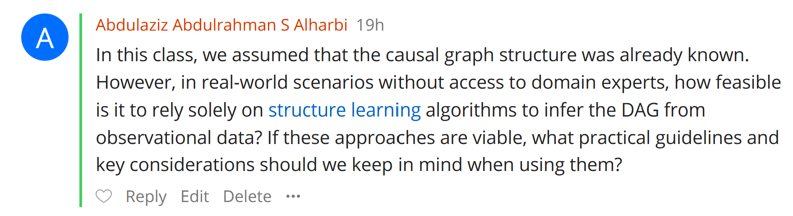

Slide 37
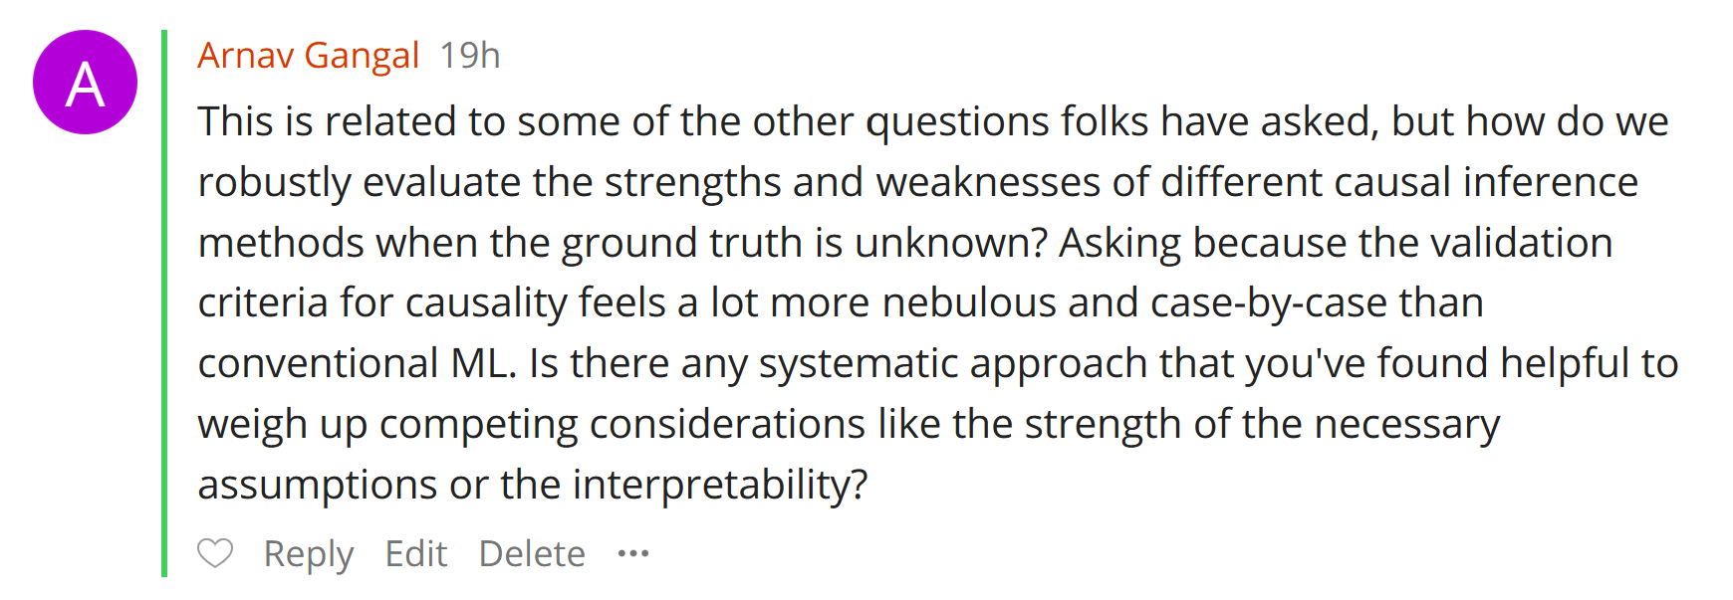

Slide 38
Stability and calibration
Using a small experimental sample to validate
Using multiple observational datasets and separately estimating, with agreement
GoTo:
Doubly robust ATE estimate for binary and Partialling out estimate for categorical (first with just Lasso models on expanded features and then with generic AutoML)
Meta learners for CATE with out-of-sample doubly robust based evaluation (calibration, hypothesis tests)

Slide 39
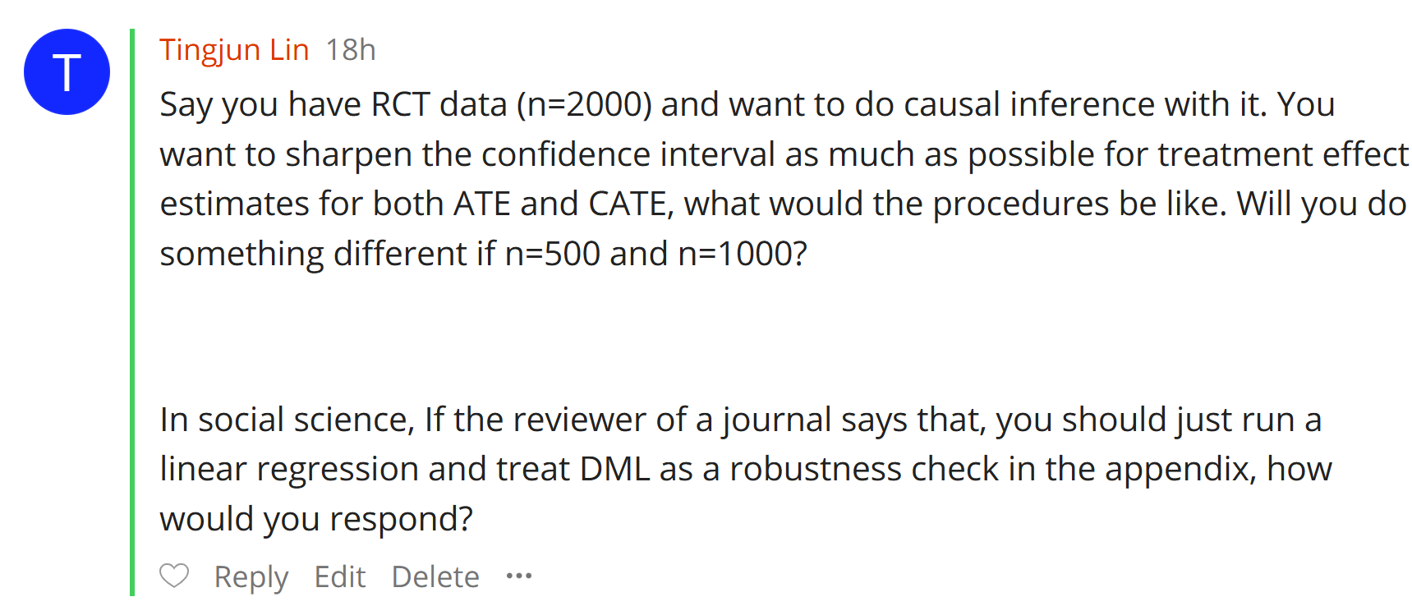

Slide 40
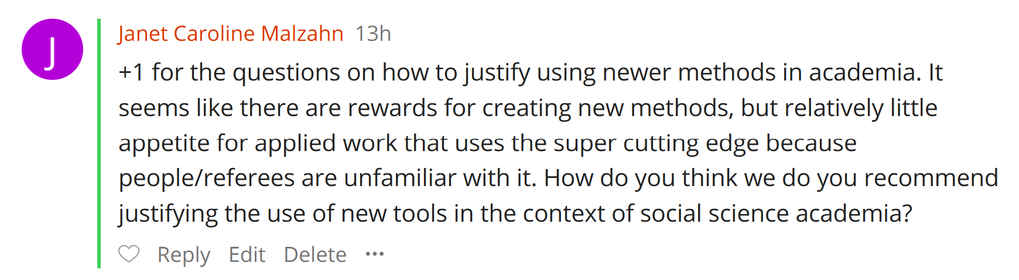

Slide 41
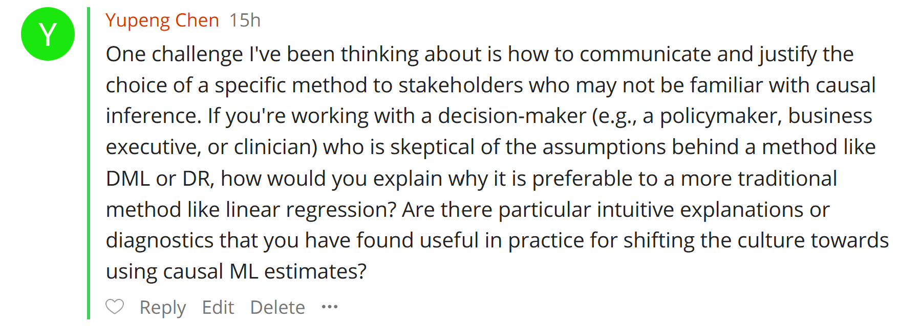

Slide 42



Slide 43
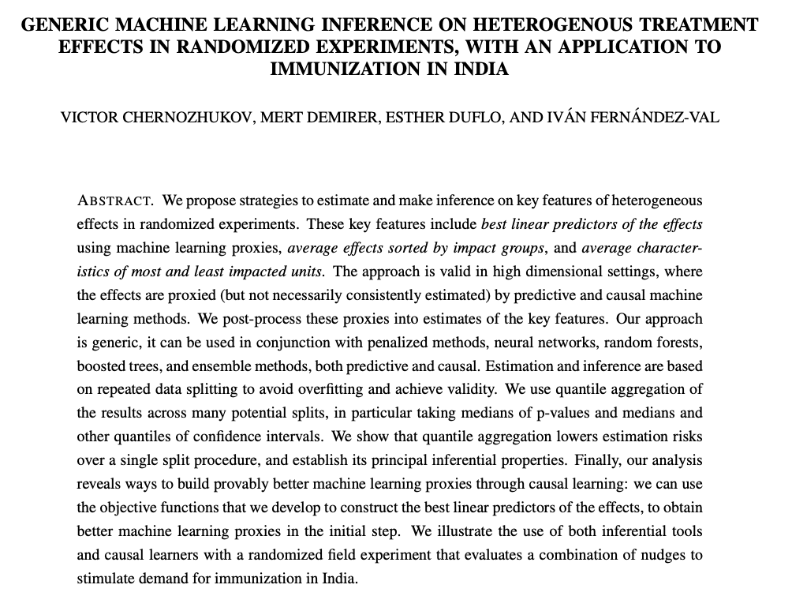

Slide 44
First, ML analogues of what you would run OLS for, are not changing the identification argument
In fact, the ML analogues are simply always “dropping” assumptions
For instance, identification by conditioning is the assumption you are invoking to identify an effect
Whether you run OLS to estimate it or ML, it does not change the identification argument
It does though drop the linearity assumption on the conditional expectations
So, from that perspective it is not bad to view it as a robustness check
If the ML method got substantially larger R^2 than OLS, then a good argument to run the ML variant.

Slide 45
One reason why the class was structured the way it was, so that we start from what people have been doing for a while (OLS) and then build on top
Example:
“CausalML Denier”: I am estimating an effect of D on Y controlling for X
“CausalML Advocate”: Oh so, really what you are estimating is the correlation of the part of D that is not linearly predictable from X, with the part of Y that is not linearly predictable from X.
“CausalML Denier”: Really?
“CausalML Advocate”: Yes, there is this famous FWL theorem that shows that OLS is equivalent to this
“CausalML Denier”: Good to know.
“CausalML Advocate”: By the way, why wouldn’t you also want to remove from Y or D the parts that can be predictable from X in a non-linear manners? Don’t you run the risk that this remnant parts are leaving some implicit unobserved confounding on the table?
“CausalML Denier”: Hm, good idea, I should be doing that, but how?
“CausalML Advocate”: Let’s talk about DoubleML…

Slide 46
Example:
“CausalML Denier”: I ran an RCT and constructed an interactive OLS model to learn effect heterogeneity
“CausalML Advocate”: Interesting! How well does your heterogeneous effect model prioritize into treatment?
“CausalML Denier”: Hm…how do I judge that?
“CausalML Advocate”: Well, there’s these cool AUC and QINI curves that tell you exactly that and can help you decide how well your effect model is for stratification
“CausalML Denier”: Good to know.
“CausalML Advocate”: By the way, what if effect differs only if some people are low-income and old? Did you include interactions in your OLS?
“CausalML Denier”: Hm, good idea, but if I start doing that the number of variables will explode and OLS is very unstable
“CausalML Advocate”: Let’s talk about Meta-learners and Causal/Doubly Robust Forests… You can automatically segment the population. Then you can also check if the complex model did better than your original OLS using the AUC curve. If it does better you can also un-pack what the model discovered by coarsely visualizing the model as a decision tree, or by using methods for feature importance for generic ML

Slide 47
Example:
“CausalML Denier”: Once I condition on demographic information X, proximity to college Z is a great instrument, to estimate the effect of college D on income Y
“CausalML Advocate”: Fantastic! How will you estimate this on data?
“CausalML Denier”: I’ll run 2SLS, with “treatments” (D,X) and instruments (Z,X)
“CausalML Advocate”: Interesting, does that estimate the average effect among compliers?
“CausalML Denier”: I think so. That’s what I know is happening when we don’t have X. Isn’t it the case with X too?
“CausalML Advocate”: Not really. When you have X’s the analogue of the LATE is the ratio of the (average effect Z->Y) / (average effect Z->D)
“CausalML Denier”: Exactly, and this is what implicitly is estimated in the two OLS stages of 2SLS
“CausalML Advocate”: Hm… not really. This only the case if Y is a linear function of Z and D is a linear function of Z… More generally, this analogy breaks
“CausalML Denier”: but then what should I do?
“CausalML Advocate”: Let’s talk about DoubleML for IVs….

Slide 48
Other strategies to convince “non-believers: run out-of-sample diagnostics on your causal ML model that are based on OLS or simple summary statistics!
Example: BLP using ML-CATE predictions as features
Example: Calibration
Example: Group average effects for groups defined based on ML-CATE
Example: Interactive OLS regression where the ML-CATE is one of the features you use to interact
Similarly, instead of doubleML, you could train a model to predict the outcome from X, train a model to predict the treatment from X, then use the predictions of these models as extra features you are controlling for in an OLS regression. This is double ML in-disguise. And you can pitch it as: I’m only using ML for clever feature engineering and then just running your favorite OLS regression ☺

Slide 49
Winter 2023 Questions

Slide 50
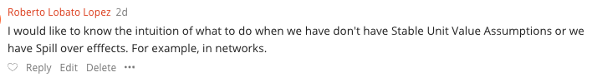

Slide 51

Interference
Social Network interference
Equilibrium effects
Stateful systems and time effects

Slide 52














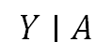
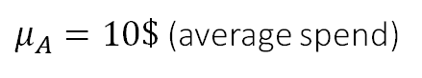
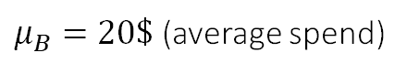
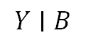
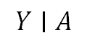
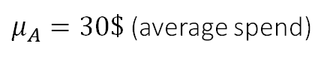
Social Network Interference
Counterfactual world
% of people
A
A
A
A
$$Y∣A$$
A
A
A
B
A
A
A
A
A
B
A
A
B
B
B
$μ_{A}=10\$$ (average spend)
A
A
B
A
A
A
B
% of people
A
B
% of people
A
$$Y∣B$$
B
B
B
$$Y∣A$$
A
A
$μ_{B}=20\$$ (average spend)
$μ_{A}=30\$$ (average spend)
Image Source: https://www.leadpages.com/blog/ab-testing-split-testing/

Slide 53


Image source: https://blog.hootsuite.com/social-media-ab-testing/

Slide 54
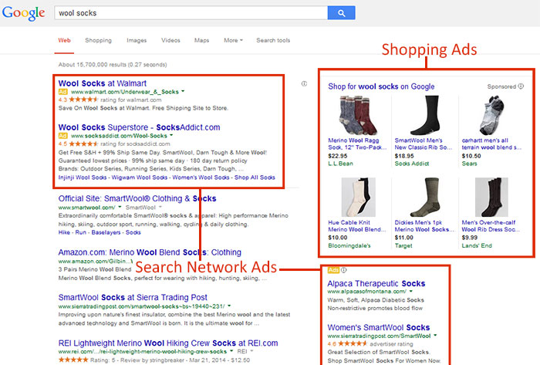
Image source: https://googleadsstrategy.com/google-adwords-search-network-vs-display-network/

Slide 55

Image source: https://www.uber.com/us/en/drive/driver-app/how-surge-works/

Slide 56
Approach: Clustering
% of people
$$Y∣A$$
A
A
B
A
A
B
A
$μ_{A}=10\$$ (average spend)
B
A
B
% of people
B
B
$$Y∣B$$
B
B
B
B
B
$μ_{B}=20\$$ (average spend)
Image Source: https://www.leadpages.com/blog/ab-testing-split-testing/

Slide 57
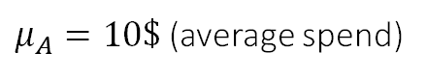
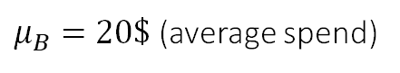

Approach: Structural Bias Correction
% of people
% of people
$$Y∣A$$
$$Y∣A$$
B
A
Correct Spill-Over Bias
B
A
B
B
B
$μ_{A}=10\$$ (average spend)
$μ_{A}=10\$$ (average spend)
A
Use Network Information + Assumptions on how spill-overs change outcome
(e.g. additive homophily effects, market equilibrium behavior, Nash equilibrium behavior)
A
B
% of people
% of people
B
A
$$Y∣B$$
$$Y∣B$$
B
B
B
A
A
$μ_{B}=20\$$ (average spend)
$μ_{B}=20\$$ (average spend)
Image Source: https://www.leadpages.com/blog/ab-testing-split-testing/

Slide 58


Slide 59
Survival Data
If your outcome is survival then you need to adjust for censoring
Easiest way to combine with what we've learned
Focus on un-censored samples
De-bias the "selection" by dividing the observed outcomes by the probability that censoring doesn't happen by the time of the observation Pr(C > t | X)
Can be estimated via reduction to many classification problems or via CDF estimators (Nelson-Aalen estimator; Survival Forests)
Then apply all that we learned on these "transformed outcomes"
More tailored:
Estimation of Heterogeneous Effects with Survival Outcomes
Meta Learners for Survival Data R-package

Slide 60
Survival Analysis and CATE
Xu et al. "The Systolic Blood Pressure Intervention Trial (SPRINT) is a multicenter RCT that evaluated the effectiveness of an intensive blood pressure (BP) treatment goal (systolic BP < 120 mm Hg) as compared to the standard BP goal (< 140 mm Hg) on reducing risks of cardiovascular disease (CVD). SPRINT recruited 9,361 participants and found that the intensive treatment reduced the risk of fatal and nonfatal CVD and all-cause mortality for patients at high risk of CVD events [Wright et al., 2015]."

Slide 61


Slide 62
Modern Challenges of A/B tests
Interference
Long range objectives
Multiple exposures over time
Non-compliance

Slide 63



Slide 64

Operations Management​ and business decision making (non-digital)

Slide 65



Diff-in-Diff requires observing two periods from each unit Y1, Y2
Y1 pre-treatment Y2 post-treatment
Assumes conditional exogeneity on time-difference in potential outcomes (aka parallel trends)
Y1(0) - Y2(0) independent of D given X => We can estimate E[Y1(0) - Y2(0) | D=1] (identification by conditioning)
We then observe
E[Y2(1) - Y2(0) | D=1] = E[Y2(1) - Y1(0) + Y1(0) - Y2(0) |D=1] = E[Y2 – Y1 | D=1] - E[Y2(0) - Y1(0) | D=1]
Equivalent to Average Treatment effect on the treated (ATT)! Can deploy doubly robust estimate for ATT.

Slide 66



Slide 67

EECS (04-09) (Athens, Greece)
Cornell CS PhD (09-14): Theoretical Computer Science; Algorithmic Game Theory
Microsoft Research NYC Postdoc (14-16): Machine Learning theory, Online Learning Theory
Microsoft Research New England (16-22) (Researcher; Principal Researcher): Causal Machine Learning, Econometrics; The ALICE Project and EconML
Stanford MS&E (22-)

Slide 68




Slide 69


https://causal-machine-learning.github.io/kdd2021-tutorial/
https://drive.google.com/file/d/1QJJUCo4LH5kGQP3kaJlG1RdhjhaJWp-5/view
https://docs.google.com/presentation/d/1FvRtis2fm4c2R7XmRKWMTtZaZjUObW1fGxpNmapmjKI/edit#slide=id.ge6ef5be800_0_478
https://drive.google.com/file/d/1yyIu_3epIVXbwzJj658Iv4vxHGjtPh8n/view
https://drive.google.com/file/d/1FEKXFHHATntHjsEymXnEw6GAiUGMm8sG/view

Slide 77



Slide 78
Many Research Challenges
Robustness to data corruption/adversarial attacks
Data Collection
[NeurIPS’17, NeurIPS’21 MLEcon workshop]
Identification Strategy
[NeurIPS’21a,b]
Estimation/Inference
[COLT’19\R&R AoS, COLT’20, NeurIPS’20, NeurIPS’21]
Sensitivity Analysis
[Arxiv’21]
Active data collection
[EC’15/OR’20, EC’26/OR21, ICML’16, NeurIPS’16, FOCS’17, ICML’18a,b, ICML’21]
Domain Assumption Elicitation
[Clear’22]
Interpretation/Policy Recommendations
[NeurIPS’19, ICLR’21,CLear’22]
Validation
[COLT’19]
Long-term outcomes
Safety constraints
Fairness and ethical constraints
Experimentation constraints (ability to intervene on subsets of variables)
Interactive assumption elicitation (query complexity)
Causal Representation Learning for unstructured data
Incorporate non-graphical restrictions in automated graph-based identification algorithms
Computationally efficient sensitivity analysis
Automated de-biasing in general (e.g. dynamic regime, mediation effects)
Unobserved confounding
Post adaptive data collection inference
Post causal discovery inference
Evidence based interpretations for policy makers
Causal attribution
Good losses for causal model selection

Slide 79
https://github.com/causaltext/causal-text-papers

Slide 80

https://insitro.com/

Slide 81



Typo! Should have been W

Slide 82


https://towardsdatascience.com/be-careful-when-interpreting-predictive-models-in-search-of-causal-insights-e68626e664b6
Partialling Out DoubleML

Slide 83


Slide 86
Causal Inference in Economics
Beyond RCTs, methods that handle unobserved confounding are much more credible and more frequently used
Instrumental Variables (demand, labor, education)
Difference in Difference
Regression Discontinuity
Synthetic Controls (country level program evaluation)

Slide 87





Slide 88



Slide 89




Slide 90

Believing that if you blindly control for a gazillion of features you have addressed unobserved confounding
Trying to extra heterogeneity from very few samples
Blindly using recent causal ml techniques as if it was a predictive problem without understanding anything about the data
Believing that if you use machine learning to control, you fixed your unobserved confounding problem

Slide 91



Slide 92

Yes, if you assume such a linear SEM this is the implicit assumption on the potential outcomes! (quite restrictive indeed) Can be relaxed if we only assume that the epsilon is un-correlated with all the other variables, not just independent. Then that implicitly allows for epsilon to depend on treatment d, but should always be mean zero

Slide 93

If you have a strong predictor of the treatment that was omitted by the single lasso due to regularization (as other factors were much stronger for the outcome), it is as if you did not control for that variable. This yields strong confounding bias.

Slide 94






Slide 95



https://sites.google.com/view/caudyn2022
http://networks.ece.mcgill.ca/sites/default/files/A%20Tutorial%20on%20Causal%20Inference%20in%20Dynamical%20Systems.pdf

Slide 96

Double lasso for ATE (for continuous treatments); Doubly Robust (for categorical)
Double lasso with feature interactions for quickly seeing if there is heterogeneity
Generic meta learners with out of sample doubly robust validation for more flexible heterogeneity

Slide 97

Stability and calibration
Using a small experimental sample to validate
Using multiple observational datasets and separately estimating, with agreement
Conformal inference cannot target expected effects, only individual (random effects) and typically will yield very large intervals
GoTo:
Doubly robust ATE estimate for binary and Partialling out estimate for categorical (first with just Lasso models on expanded features and then with generic AutoML)
Meta learners for CATE with out-of-sample doubly robust based evaluation (calibration, hypothesis tests)

